Slide 1
CASE STUDY: PPAS RAJA TUN UDA SHAH ALAM
IMD 311 : INTRODUCTION TO WEB CONTENT MANAGEMENT OF DESIGN
SIR AHMED NOOR KADER MUSTAJIR MD EUSOFF
CREATED BY:
NUR SHAMIMI BINTI ABDUL HAFIDZ ( 2017184013 )
AINUL SALSABILA BINTI AIDI ( 2017389891 )
NABILA FATIHA BINTI ROSLY ( 2017385589 )
NURAMIRAH BINTI KHAIRULZAMAN ( 2017333543 )

Slide 2
BACKGROUND OF THE WEBSITE
This website are own by Perbadanan Perpustakaan Awam Selangor (PPAS) itself
This website can be browse by any type of web browsers
The best resolution for this website are 1280 x 800
The type of this website are dynamic website

Slide 3
Programming used to make this website
HTML
CSS
JavaScript
JQuery
Extensible markup language (XML)
XMLHttpRequest (XHR)
Windows servers

Slide 4
2.0 NATURE BUSINESS OF THE WEBSITE
The nature business of PPAS website leading more towards:
Rent of facilities
Member registration
Where all the details could be found:
Findable on the homepage at the customers’ menu section.
The website compact with variety of information.
The services available in PPAS are not limited in the form of materials request and borrowing.

Slide 5
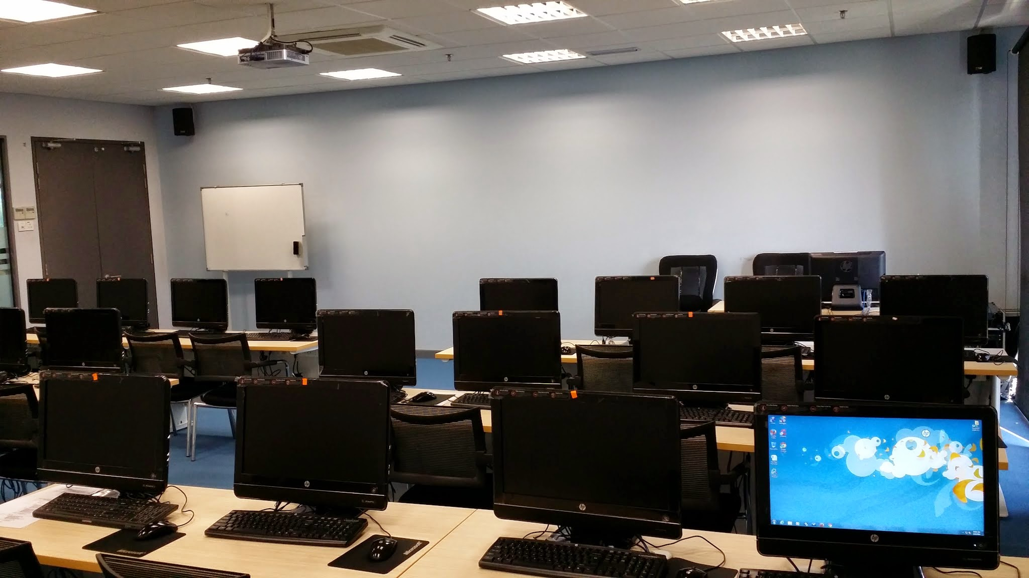
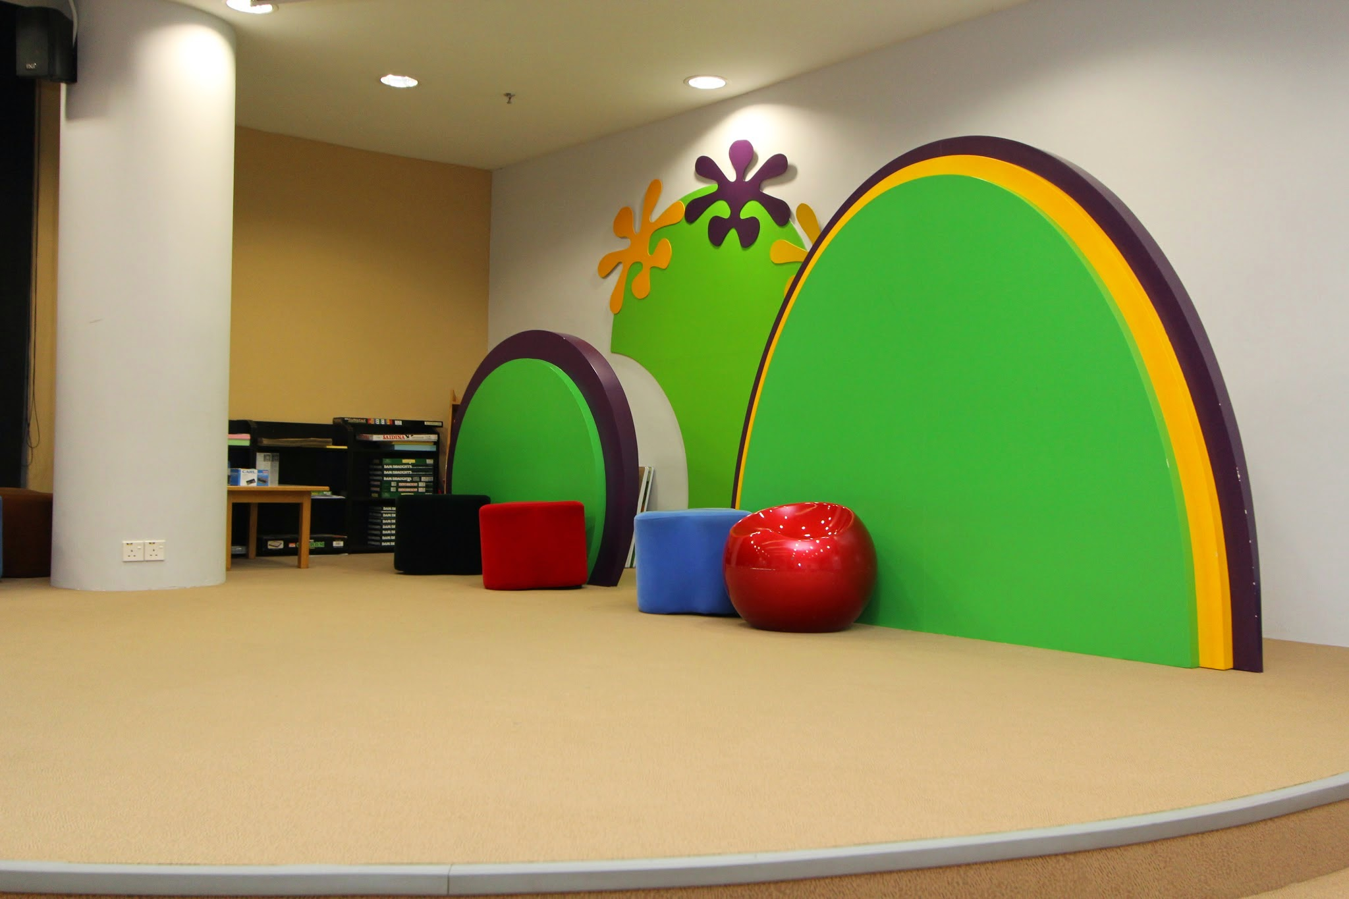
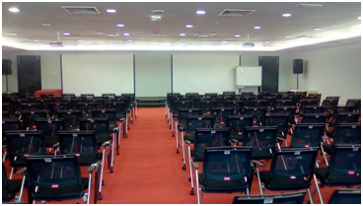
TYPES OF FACILITIES AVAILABLE IN THE LIBRARY
INFORMATION TECHNOLOGY LAB
CHILDREN ACTIVITIES ROOM
SEMINAR ROOM

Slide 6
CONT;
Who is allowed to use the services:
There is no limitation of who had the ability to get the services.
It was made for the public.
How the nature of business was done?
The requirement for users to get further details from the reference desk, in order to proceed the booking process.
Member registration done through online or at the reference desk.
Why PPAS considering to operate the businesses through online:
The consideration is a part of the library administration and services development.
It should be align with current technologies advancement.

Slide 7

CONT;
Users’ definitely should start exploring the services provide by a library since it is truly beneficial for them.

Slide 8
Ui/ux of the website
Design
Their design is focus on giving a useful informations
The website layout is simple and easy to find informations
Visual appearance
The typography is Arial, Helvetica, and sans-serif
The iconography for FAQs, feedback, contact, social media
Suggestion
They should put some creative elements such as a creative card UI design

Slide 9


Colour scheme use
PPAS decided to use a plain light background such as white colour
Neutral colour which is grey for the navigation bar and white for the text
The overall primary colour – blue
The most secondary colour – orange

Slide 10
Navigation of the website
NAVIGATION BAR
It is static in every webpages and easy to use.
Users can see it directly when they are on the website
NAVIGATION SIDEBAR
Customers’ menu and staff menu which helps users differentiate the different services aimed for them.
SITEMAP
Lists of navigation to other parts of the website.
Users are able to find the link of the page they need to go to without distraction.

Slide 11
Cont..
DROPDOWN
Drops list under the initial parent element for example under Services, there are a lot of more services.
ICONS
Visually visible for the users for example, the International Wheelchair Symbol will helps users with disability to click on the icon for more information.

Slide 12
Content of the website
HISTORY OF LIBRARY
Essential to let users know about the history of the library. It is factual yet concise and has minimal usage of text.
SLIDESHOW IMAGES
Contains slideshow images for important news related to the library. It can draw users’ attention with the usage of huge and bright-in-color text.
SERVICES
Important to let users know about the services the library offers. Easy to understand and important sentences are bolded.

Slide 13
Cont..
USAGE OF IMAGES
Uses images to convey message. For example, the services section also has images for users to visualize the service.
LATEST NEWS SECTION
Where the library posts recent news and events. Helps users to find out about the news plus it can draw users’ attention with a blinking button.

